Slide 1
ISM 6136
Data Mining
Dr. Tim Smith

Slide 2
Learning outcomes :
Data Preparation
Addressing data imbalance
Evaluation Metrics
ROC and ROC AUC
Modeling Techniques
SVM/SVC
Decision Trees

Slide 3
Data Preparation: Addressing data imbalance

Slide 4
Data Imbalance
Data imbalance refers to a situation in which the classes within a labeled dataset are not represented equally or proportionately.
This is a common scenario in various fields, including but not limited to medical diagnosis, fraud detection, and natural language processing.

Slide 5
Types of Imbalance
Binary Imbalance:
The most straightforward type, where one class is underrepresented.
Multiclass Imbalance:
Involves more than two classes, where one or multiple classes are underrepresented.
Imbalanced Cluster Sizes:
In clustering problems, some clusters may have significantly fewer members.
Sequential Imbalance:
In time-series or sequence prediction, specific sequences may be underrepresented.

Slide 6
Implications of Data Imbalance
Skewed Model Performance:
Most machine learning algorithms are designed to maximize overall accuracy, which can be misleading when classes are imbalanced. The model may predict the majority class to achieve high accuracy, leading to poor generalization.
Misleading Evaluation Metrics:
Traditional metrics like accuracy do not effectively capture the model’s performance when the data is imbalanced.
Risk of Overfitting or Underfitting:
If not implemented carefully, resampling methods can lead to models that are either too complex (overfitting) or too simple (underfitting).

Slide 7
When Rebalancing Might Be Necessary:
Skewed Performance Metrics:
In an imbalanced dataset, traditional evaluation metrics like accuracy can be misleading. A classifier might achieve high accuracy by simply predicting the majority class, which could be disastrous in critical applications like medical diagnosis or fraud detection.
Inadequate Minority Class Representation:
If the minority class is not well-represented, the model may not have enough information to classify instances of that class, making rebalancing beneficial correctly.
Domain Sensitivity:
In some fields, the cost of a false negative could be significantly higher than a false positive or vice versa. For example, in cancer prediction, a false negative can be life-threatening, which may necessitate balancing the classes for better sensitivity.
NOTE: As we have seen with model evaluation metrics, some of these issues can also be addressed by evaluation metrics selection.

Slide 8
When Rebalancing Might Not Be Necessary
Real-World Distribution:
Sometimes, the imbalanced dataset reflects the real-world distribution of the classes. For instance, fraudulent activities are rare in fraud detection compared to non-fraudulent ones. In such cases, rebalancing might lead the model to predict more false positives, which may not be desirable.
Strong Classifiers:
Some machine learning algorithms, like Random Forest or ensemble methods, may perform adequately on imbalanced datasets without resampling.
Cost-Sensitive Learning:
Instead of resampling, you can adjust the classification threshold or use cost-sensitive methods that weigh the classes differently, effectively paying more attention to the minority class.
High-Quality Data:
If the available instances of the minority class are highly informative and representative, rebalancing might not be necessary.
Computational Constraints:
Resampling techniques, especially oversampling, can significantly increase the size of the dataset, leading to increased computational costs. This could be problematic if resources are limited.
Risk of Overfitting:
Techniques like SMOTE can create synthetic instances that could lead to overfitting, primarily if not implemented carefully.

Slide 9
Techniques to address Data Imbalance
Over-sampling
Under-sampling
SMOTE
ADASYN

Slide 10
Undersampling:
Advantages
Computational Efficiency:
One of the primary benefits is the reduction in dataset size, which leads to faster training times for machine learning models.
Reduced Risk of Overfitting:
With a balanced dataset, the model is less likely to overfit to the majority class, potentially improving generalization to new data.
Simplicity:
Undersampling is straightforward to understand and implement. There are no complex calculations involved, unlike in oversampling techniques like SMOTE.
Focus on Minority Class:
By reducing the size of the majority class, the relative importance of the minority class instances increases, which can improve the model’s performance metrics on the minority class.
Preserves Original Data:
Unlike synthetic oversampling techniques, all instances in the undersampled dataset are real instances from the original dataset.
Disadvantages:
Information Loss:
The most significant disadvantage is the loss of potentially useful information. By randomly removing instances from the majority class, you may discard valuable data that could be essential for classification.
Potential Underfitting:
Reducing the majority class too much may lead the model to underfit, thus performing poorly on unseen data.
Impractical for Large Imbalances:
In cases where the class imbalance is extreme, undersampling may require a drastic reduction in the majority class, making it less practical.
Variable Performance:
The random nature of undersampling can lead to inconsistent model performance, depending on which instances are removed.
Biased Estimates:
The change in class distribution can result in biased estimates of class probabilities, which might be a problem for certain applications.

Slide 11
Oversampling
Advantages of Oversampling
Increased Sensitivity:
Oversampling can improve the model's ability to detect the minority class, which can be crucial in fraud detection or medical diagnosis applications.
No Information Loss:
Unlike undersampling, oversampling does not result in the loss of instances from the majority class, preserving all the information in the dataset.
Improved Accuracy:
Because the dataset becomes more balanced, the classifier often has a better predictive accuracy, especially on the minority class.
Better Model Complexity:
With more data points to learn from, machine learning algorithms have the potential to capture more complex patterns.
Disadvantages of Oversampling
Computational Cost:
As the dataset size increases due to oversampling, the computational cost of memory and time also increases, especially for algorithms with higher time complexity.
Increased Likelihood of Overfitting:
More data points from the minority class can lead the model to memorize the noise in the data rather than generalize, resulting in overfitting.
Distorted Class Distributions:
Synthetic oversampling methods can change the underlying distribution of classes, potentially leading to less generalizable models.

Slide 12
SMOTE: Algorithm
1. Select a Minority Class Instance
Randomly picking a point from the minority class.
2. Finding the k-Nearest Neighbors
Use graphics to show how k-nearest neighbors are found for the selected instance.
3. Random Neighbor and Interpolation
Choose one of the k-nearest neighbors randomly.
4. Synthesize new observation
Add data from the randomly k-nearest neighbor selected in step 3.
Parameters:
n_neighbors: Number of nearest neighbors to use to construct synthetic samples.
Sampling_strategy: Generally, the amount of the majority class is included, and the number of minority class observations to create.

Slide 13
SMOTE: Pros and Cons
Advantages:
Improved Classifier Performance:
By balancing the class distribution, SMOTE often enhances the performance of classifiers, especially on the minority class.
Reduced Overfitting:
Unlike simple oversampling, which replicates minority samples, SMOTE generates synthetic samples that are variations of the existing ones. This can result in a model that generalizes better to unseen data.
Focus on Entire Feature Space:
SMOTE considers the feature space to generate synthetic instances, which may be more representative than duplicating existing minority instances or creating new instances in the data space.
Disadvantages:
Computational Complexity:
Generating synthetic samples involves calculations over the feature space, making it computationally expensive, especially for large datasets.
Risk of Noise Introduction:
SMOTE operates based on the k-nearest neighbors principle, which could introduce noise if the neighbors are not carefully chosen or if k_neighbors is set too high.
Not Effective for High-dimensional Data:
In very high-dimensional spaces, the notion of "nearest" neighbors may become less meaningful, weakening the structure that SMOTE relies on.
Sensitivity to Outliers:
Over-reliance on SMOTE can lead to overly optimistic performance estimates, as synthetic samples may not necessarily represent real-world data points.

Slide 14
ADASYN Algorithm
1. Compute Imbalance Ratio
Define the imbalance ratio for each minority class sample based on its k-nearest neighbors in the majority class.
2. Generate Ratio-based Weights
Calculate a weight for each minority sample based on its difficulty level (i.e., how often its nearest neighbors misclassify it).
3. Synthetic Sample Generation
Similar to SMOTE, but with the number of synthetic samples generated for each minority instance determined by its weight.
Parameters:
n_neighbors: Number of nearest neighbors to use to construct synthetic samples.
Sampling_strategy: Generally, the amount of the majority class is included, and the number of minority class observations to create.

Slide 15
ADASYN: Pros and Cons
Advantages
Focuses on the more challenging to classify instances.
Often provides better classifier performance on the minority class.
Limitations
It is computationally expensive, especially for large datasets.
Potential for introducing noise due to extreme synthetic sample generation.

Slide 16
Sample Notebook
Follow along with the professor as he reviews notebook examples that address data imbalance.

Slide 17
Evaluation Metrics: ROC and ROC AUC

Slide 18
ROC AUC
Follow along with the professor as your reviews a ROC AUC example and discussion found in this weeks ROC AUC notebook.

Slide 19
Modeling: SVM/SVC

Slide 20
Introduction to SVM
Support Vector Machine (SVM): A supervised machine learning algorithm mainly used for classification but can also perform regression tasks.
Support Vector Classification (SVC): A specific application of SVM for classification.
The goal is to find a hyperplane that separates data into different classes as optimally as possible. In a 2D space, the hyperplane is essentially a line.

Slide 21
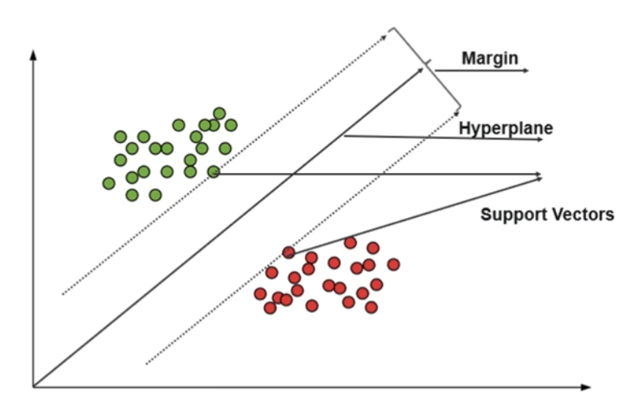
SVM/SVC Components
Decision Boundary: The hyperplane that best separates different classes.
Support Vectors: Data points that are closest to the decision boundary.
Margin: The distance between the support vectors and the decision boundary.
Image Source: edureka.com

Slide 22
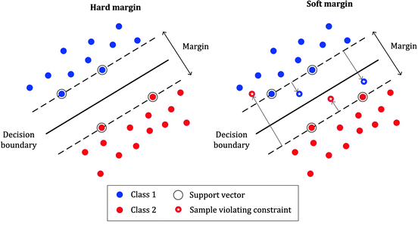
Soft versus Hard Margin
The requirement for a support vector can be ‘softened’; which means that some errors are allowed:
Image Source: medium.com

Slide 23
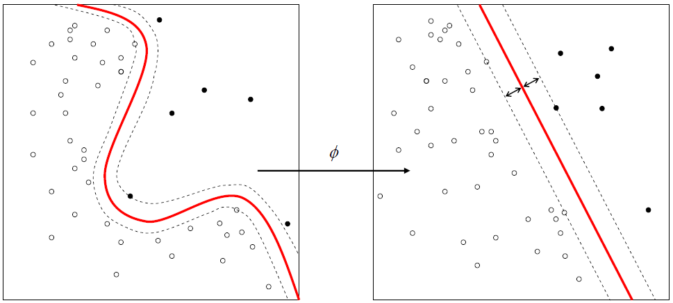
Kernels
The kernel function transforms the original feature space into a higher-dimensional one.
This makes it feasible to perform classifications for non-linearly separable datasets, thereby increasing the flexibility and power of the SVC algorithm.
Linear Kernel:
Using a linear kernel implies that the decision boundary separating the data classes is a straight line (or a hyperplane in higher dimensions).
This is most effective when the data is linearly separable or close to being linearly separable.
Non-linear kernels:
Used when the data is not linearly separable.
These kernels map the input features into a higher-dimensional space where a hyperplane can perform the separation.
Common kernels used:
Polynomial
Sigmoid
Radial Bias Kernel

Slide 24
Example notebook
Follow along with the professor as he reviews this week’s SVC notebook.

Slide 25
Modeling: Decision Trees

Slide 26
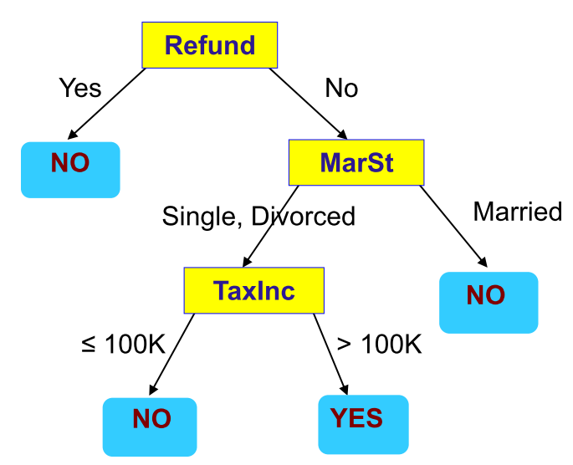
Decision Tree
Supervised Learning Model
Predictors/features/attributes as input
Predicted Output/Outcome can be checked with known result
Flowchart like Tree structure
Two types of Decision Tree:
Classification Tree (outcome is classification) ← this is our focus in this course
Regression Tree (outcome is continuous)
Root Node
Internal Nodes
Leaf Nodes

Slide 27
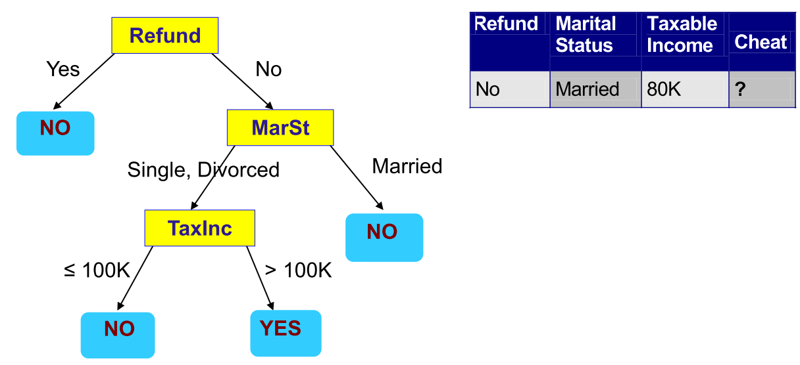
How are decision trees used for classiﬁcation?
whether a tax filer has cheated in his/her taxes

Slide 28
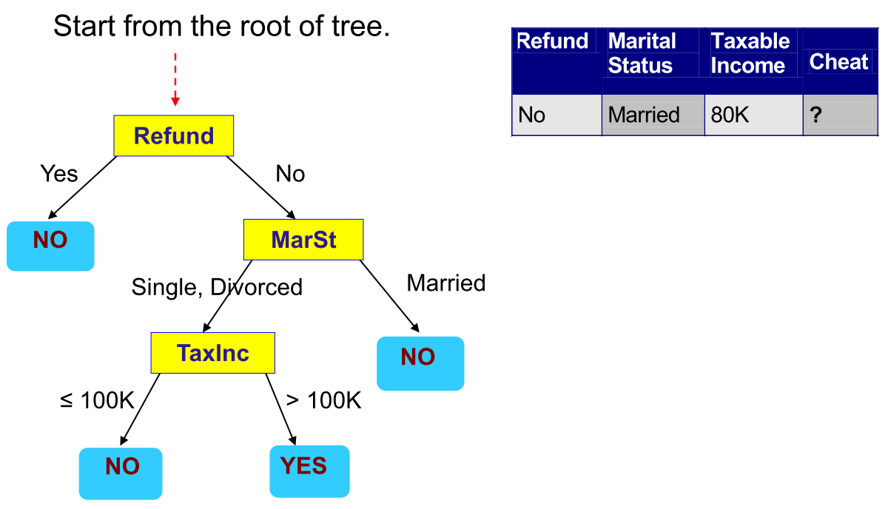
How to Use the Decision Tree?

Slide 29
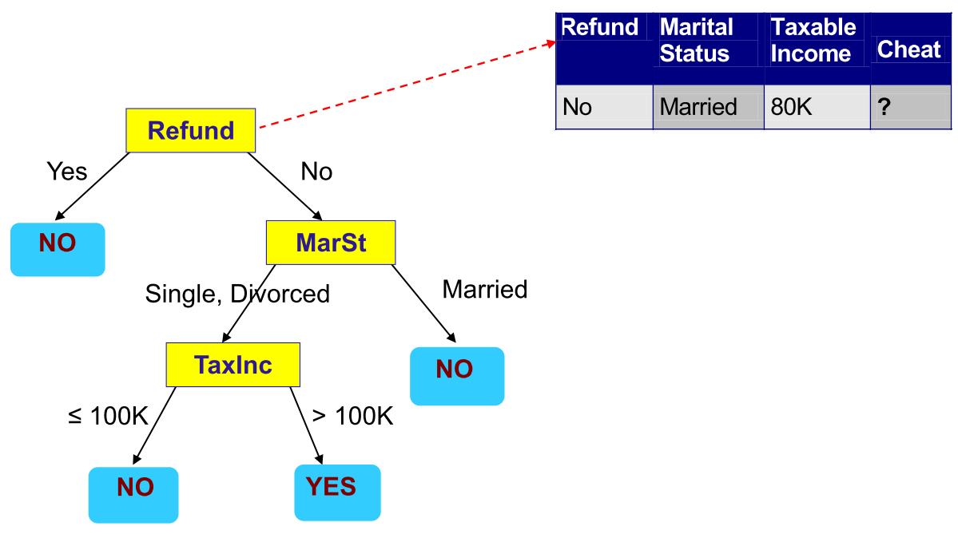
How to Use the Decision Tree?

Slide 30
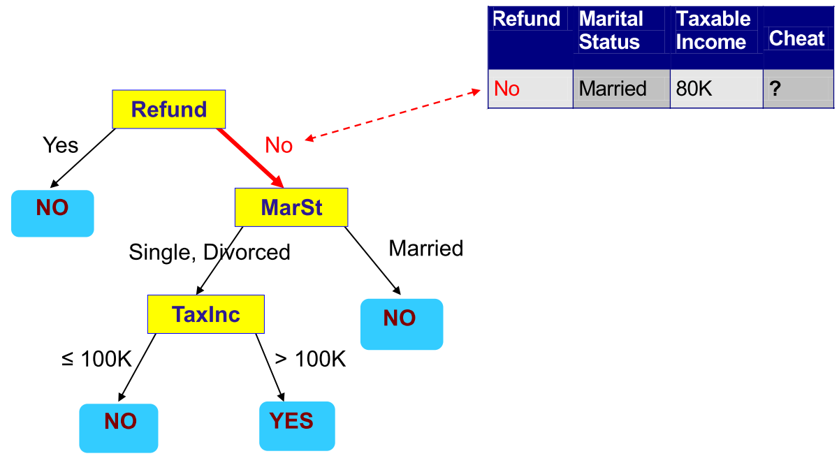
How to Use the Decision Tree?

Slide 31
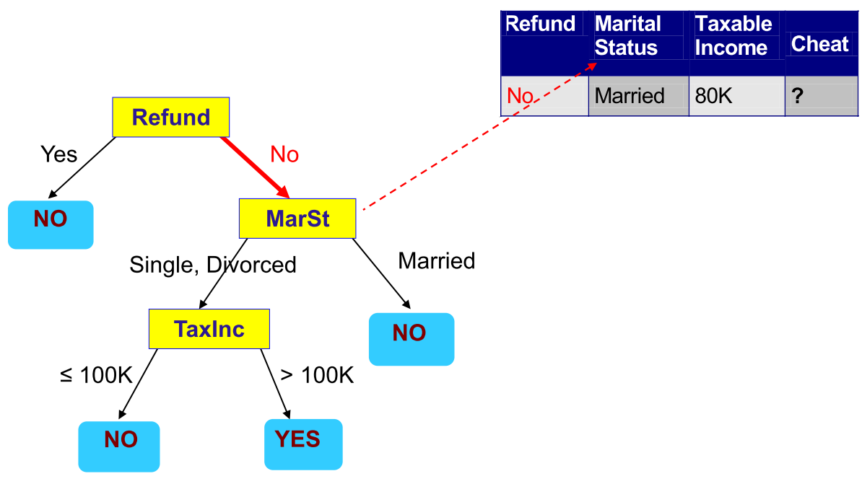
How to Use the Decision Tree?

Slide 32
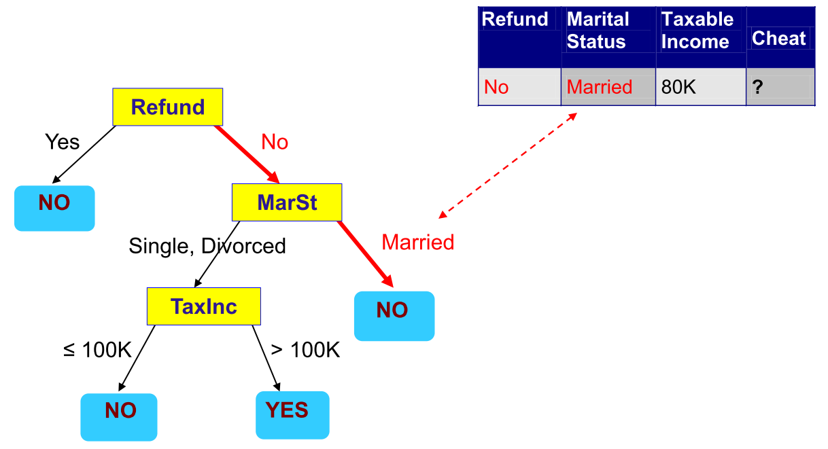
How to Use the Decision Tree?

Slide 33
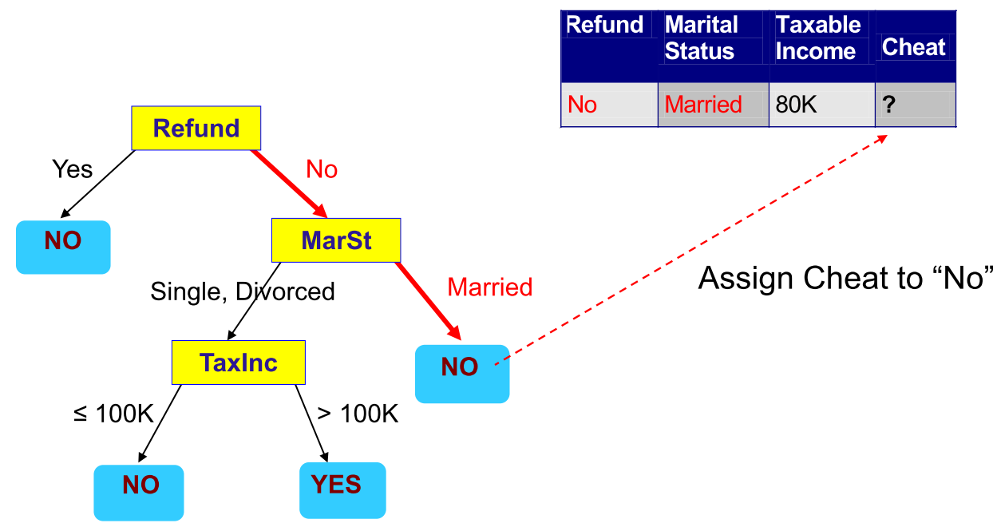
How to Use the Decision Tree?

Slide 34

Question
No
Single
123k
?

Slide 35
How to create/build decision tree
Top-down recursive partitioning
Select feature for first (root) node
Split given node into branches
Continue until no features left to use a node OR we have perfect fit

Slide 36
Building tree
How do we split a feature?
For Categorical predictor
binary – split to two branch
multiple classes – split to number of distinct classes
For continuous predictor
Binary split – optimal value
Multiple way split - binning

Slide 37
Building tree
Which order of features to split with?
Different orders of splitting will create different trees.
We’re finding the best fitting tree, so we test which node split will be better than the others.

Slide 38
Information gain as means of selecting nodes
Input Data
Input Data
More information gained
Refund Received is a “better rule
Refund Received
✓
Marital Status
Rule
Rule
Information Gain
Yes
No
Yes
No

Slide 39
How we quantify information gain?
Measure Entropy:
Higher entropy means more disorder
Lower entropy means less disorder
Measure Purity/Homogeneity
Higher purity/homogeneity means more order
Lower purity/homogeneity means less order
More disorder = more information
Less disorder = less information
If we move from more disorder to less disorder – we have extracted information

Slide 40
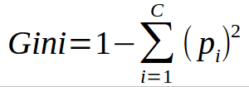
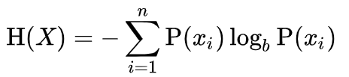
Two common measures
Gini Index – measure of homogeneity (sameness)
Entropy – another measure the accomplishes the same task
i = feature
c = # of features
i = feature
n = # of features
b = 2 (bits) or e (nats) or 10 (bans)
… use base 2
https://web.archive.org/web/19980715013250/http://cm.bell-labs.com/cm/ms/what/shannonday/shannon1948.pdf

Slide 41
Using Gini Index
Input Data
1-(3/8)²-(5/8)²= 0.46875
Marital Status
Rule
Information gain = 0.46875-0.27778 = 0.19097
Yes
No
(2/8)*0+(6/8)*0.27778=0.27778
1-(2/2)²-(0/2)²= 0
1-(1/6)²-(5/6)²= 0.27778

Slide 42
Using Gini Index
Input Data
1-(3/8)²-(5/8)²= 0.46875
Refund
Rule
Information gain = 0.46875-0 = 0.46875
Yes
No
(3/8)*0+(5/8)*0=0
1-(3/3)²-(0/3)²= 0
1-(0/5)²-(5/5)²= 0

Slide 43
Select node with greatest gain
Input Data
Input Data
Homogeneity Gain
Homogeneity Gain
0.19097
0.46875
Marital Status
Rule
Refund Received
Rule
Yes
No
Yes
No
Notes:
0.19097

Slide 44
Using Entropy Loss
Input Data
-(3/8)log₂(3/8) - (5/8) log₂(5/8) = 0.954434
Marital Status
Rule
Information gain = 0.954434-0.650022 = 0.304412
Yes
No
(2/8)*0+(6/8)*0.650022=0.650022
=-(2/2)*log2(2/2) = 0
-(1/6)log₂(1/6)-(5/6)log₂(5/6) =0.650022

Slide 45
Using Entropy Loss
Input Data
-(3/8)log₂(3/8) - (5/8) log₂(5/8) = 0.954434
Refund Received
Rule
Information gain = 0.954434-0.0 = 0.954434
Yes
No
(2/8)*0+(6/8)*0.0=0
-(3/3)*log2(3/3) = 0
-(5/5)log₂(5/5) =0

Slide 46
Select node with greatest Entropy loss
Input Data
Input Data
Entropy loss
Entropy loss
0.304412
0.9554434
Marital Status
Rule
Refund Received
Rule
Yes
No
Yes
No
Notes:
0.19097

Slide 47
“Recursive” Keep going until we either get a perfect fit, or we run out of features
Input Data
Feature 1 Rule
Rule
Yes
No
Feature 2 Rule
Yes
No

Slide 48
Why use Decision Tree?
Pro
Handles multiple features
Handles multiple classifications (beyond binary)
Simple, easy to interpret the model
Acceptable/good performance
Cons
Tends to “overfit”
Solution: “pruning”
Use other methods: Random Forest, Boosted Trees (next week)
Greedy algorithm – chooses best fit without looking ahead (for instance choosing a suboptimal split could yield better results in later splits)
Can be unstable – small variations in predictive values can result in very different trees.
We will explore solutions to this next week

Slide 49
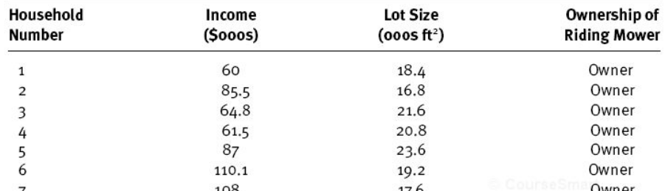
Classification Task – Example2
Example: (Imagine this is the TRAIN set)
Two predictors
(two dimensions)
Target variable
(12 owners;
12 non-owners)

Slide 50
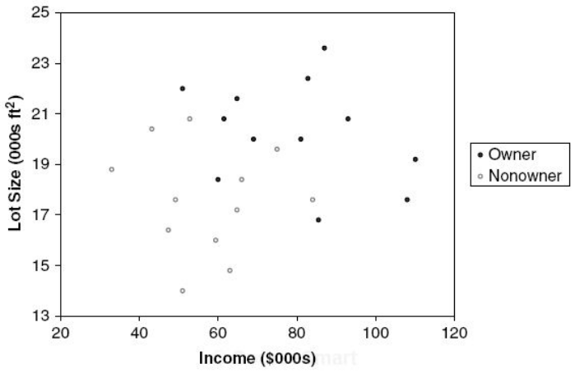
Classification Task - Example
Step 1: Create a scatterplot

Slide 51
Classification Task - Example
Step 2: Draw a vertical or horizontal line to increase the "purity" (or homogeneity) of each resulting space
Owners: 12
Non-owners: 12
Lot size
≤19
>19
Owners: 3
Non-owners: 9
Owners: 9
Non-owners: 3

Slide 52
Classification Task - Example
If you stop here: use the "majority" rule
Owners: 12
Non-owners: 12
Owners: 12
Non-owners: 12
Lot size
Lot size
≤19
>19
≤19
>19
Owners: 3
Non-owners: 9
Owners: 9
Non-owners: 3
NON-OWNER
OWNER
Which observations are misclassified?
What is the accuracy?

Slide 53
Classification Task - Example
Step 3: Draw another vertical or horizontal line to increase the "purity" (or homogeneity)
Owners: 12
Non-owners: 12
Lot size
≤19
>19
Owners: 3
Non-owners: 9
Owners: 9
Non-owners: 3
Income
≤84.75
>84.75
Owners: 1
Non-owners: 9
Owners: 2
Non-owners: 0

Slide 54
Classification Task - Example
If you stop here: use the "majority" rule
Owners: 12
Non-owners: 12
Owners: 12
Non-owners: 12
Lot size
Lot size
≤19
>19
≤19
>19
Owners: 3
Non-owners: 9
Owners: 9
Non-owners: 3
Owners: 3
Non-owners: 9
OWNER
Income
Income
≤84.75
>84.75
≤84.75
>84.75
Owners: 1
Non-owners: 9
Owners: 2
Non-owners: 0
NON-OWNER
OWNER

Slide 55
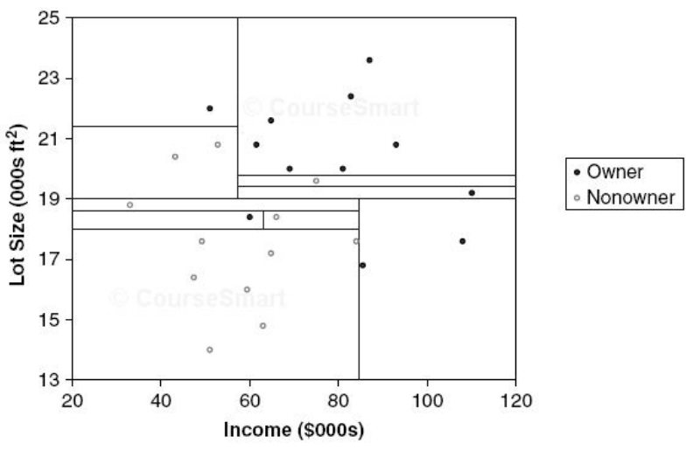
Classification Task - Example
Step 4: Continue until each resulting space is homogeneous
No cell has any "impurity"
What is the risk of eliminating all impurities?

Slide 56
Recursive Partitioning (CART)
How does the algorithm identify the split points:
Variable 1
(Income)
Variable 2
(Lot size)
Variable 3
(…)
Try all splits
Try all splits
Find the reduction in "impurity" after each split
Find the reduction in "impurity" after each split
When does it stop:
Either: hit the max depth
Or: there is no improvement in reducing impurity
Rank the results
repeat
Select the best

Slide 57
Recursive Partitioning (CART)
Scikit uses modified CART
CART is a greedy algorithm
Creates a split and moves on
Doesn’t go back to the previous split to see if it would lead to the lowest impurity
It may not converge on the optimal solution (but “reasonably” close to it)

Slide 58
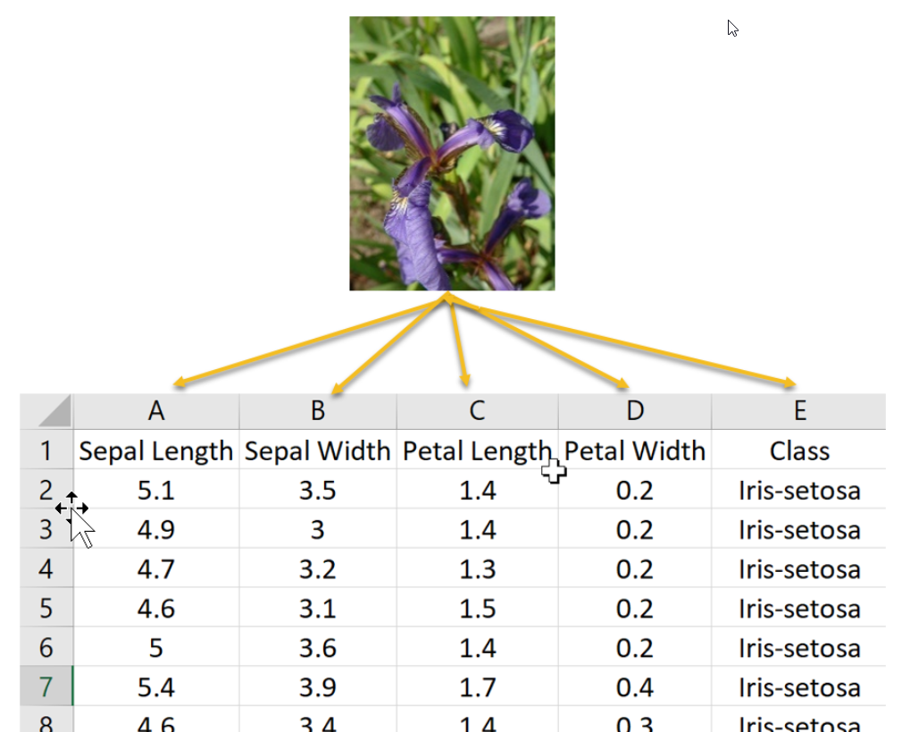
Tree Structure – SciKit version
Iris data set: (multiclass)
Source: oreilly.com

Slide 59
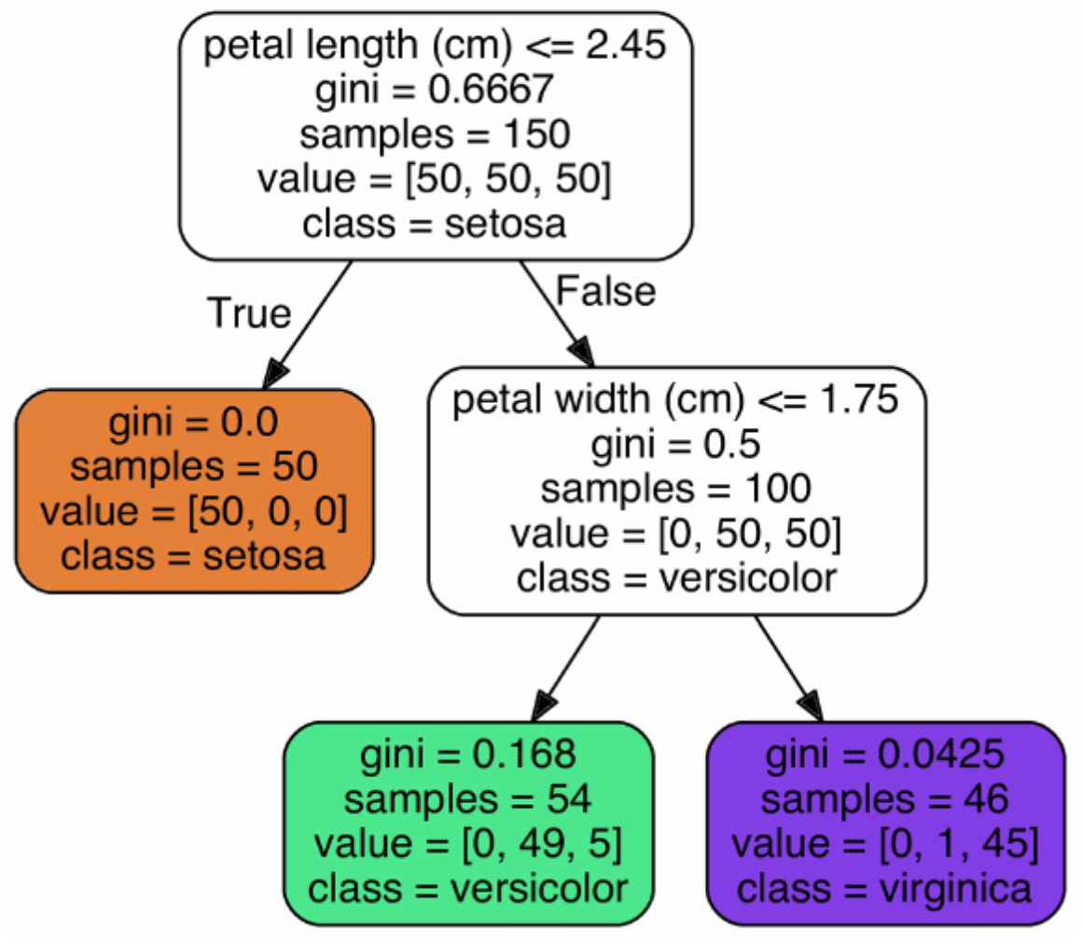
Tree Structure – SciKit version
Iris data set: (multiclass)
Root node
# of obs. in each class:
[Setosa, versicolor, virginica]
Split variable (and condition)
Gini “impurity” index =
1 – [(0/46)² + (1/46)² + (45/46)²]= 0.0425
Leaf node
(terminal node)
Classification

Slide 60
Tree Structure – SciKit version
Class probabilities:
# of obs. in each class:
[Setosa, versicolor, virginica]
Setosa probability: 0%
Versicolor probability: 91%
Virginica probability: 9%

Slide 61
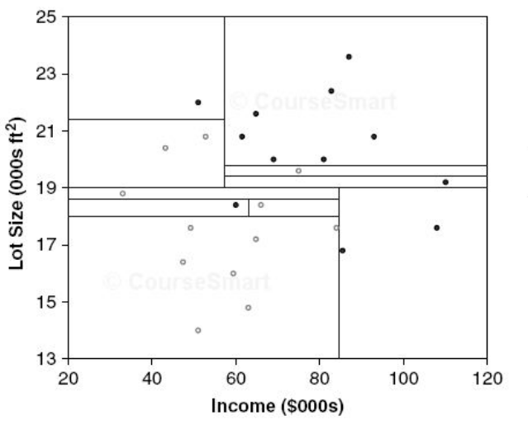
Overfitting
Too many splits cause overfitting:
Overfitting
Fewer splits?
versus

Slide 62
How to Avoid Overfitting
“Regularization” (restrictions) using hyperparameters:
Max_depth: how far can the tree go (default is unlimited)
Min_samples_split: min # of obs. a node must have before a split
Min_samples_leaf: min # of obs. a leaf node must have
Min_weight_fraction_leaf: fraction of min_samples_leaf
Max_leaf_nodes: max # of leaf nodes
Max_features: max # of features examined at each node

Slide 63
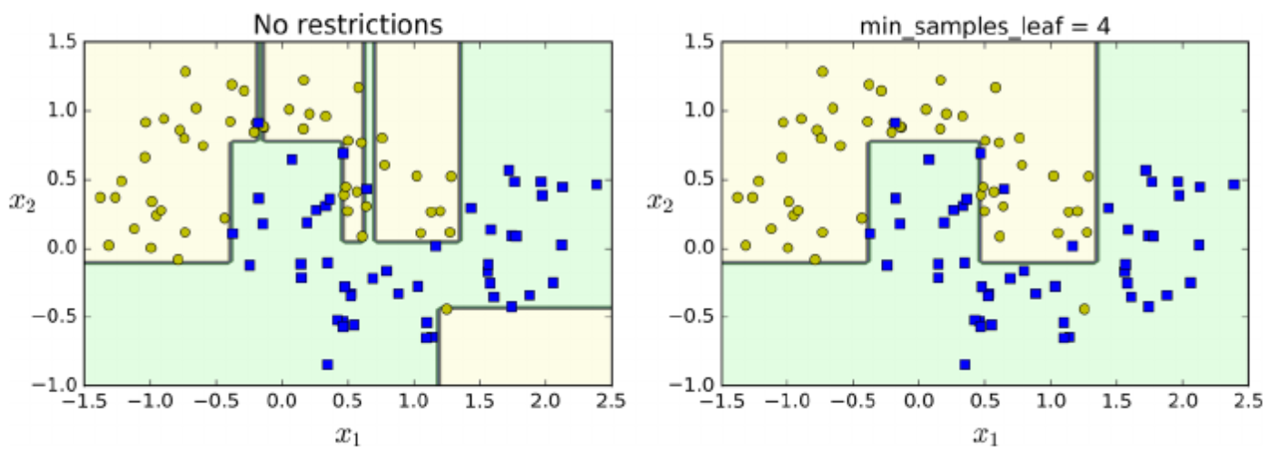
Regularization

Slide 64
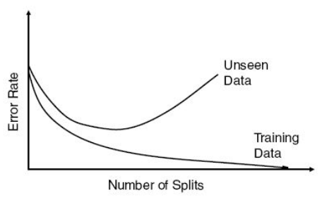
Avoid Overfitting
Write code in Python:
Tree size | Training error rate | Validation error rate
… | … | …
9 | 2.2 | 1.67
10 | 1.6 | 1.67
11 | 1.2 | 1.47
12 | 1.2 | 1.60
13 | 1.2 | 1.60
14 | 1.16 | 1.70
… | … | …
Optimal size
(validation data)

Slide 65
Decision Trees - Regression
Target variable is continuous
Procedure is the same:
Create splits
Instead of "impurity", minimize mean squared error
Take the "average" of the target variable in the leaf node
Disadvantage of Regression Trees: they generate the same value for each observation at the leaf node!

Slide 66
Happy Learning!

